Slide 1

Car Sell Dekho Analysis

Slide 2




Read the dataset
Print the total count of the records

Slide 3
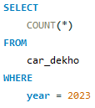
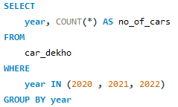


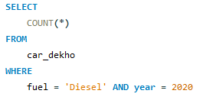
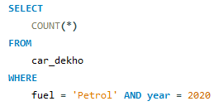


How many cars are available in 2023 ?
How many cars are available in 2020, 2021, 2022 ?
How many diesel cars are available in 2020 ?
How many petrol cars are available in 2020 ?

Slide 4
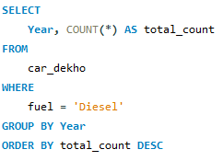
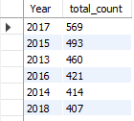
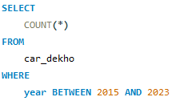

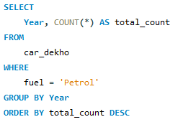
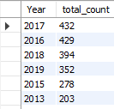
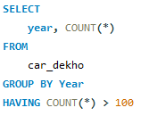
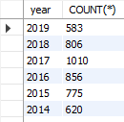
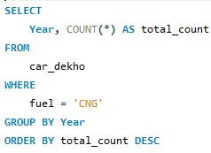
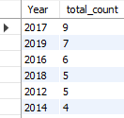
Print the count of all fuel cars(Petrol, diesel and CNG) year wise in Descending order
Print the count of all cars pertain between year 2015 and 2023
Print the count of all cars pertain between year 2015 and 2023

Slide 5
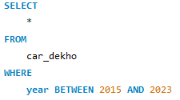

Print the details of all cars fall in year 2015 to 2023

